Slide 1
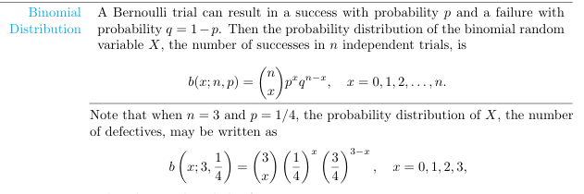

Slide 2
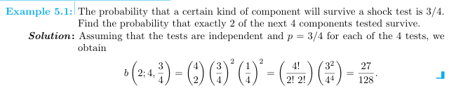

Slide 3
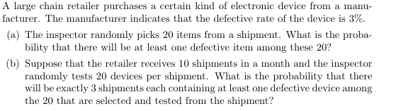

Slide 4
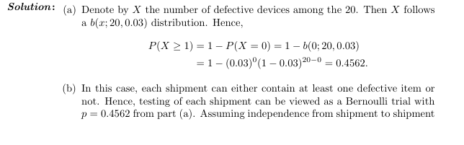
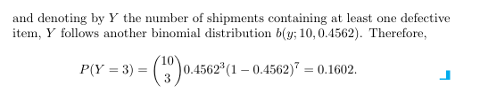

Slide 5

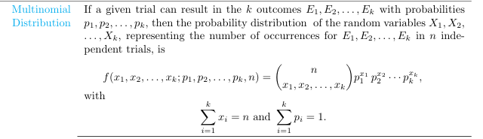

Slide 6
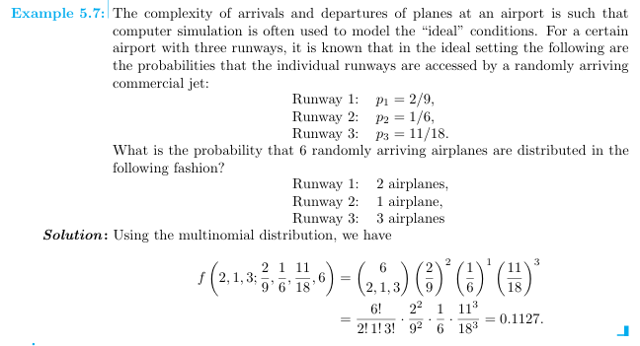

Slide 7
The Poisson distribution is used when modeling the number of occurrences of an event within a fixed interval of time, space, or another domain, given the following conditions:
When to Apply the Poisson Distribution:
Counting Discrete Events: The distribution applies to the count of discrete events that occur in a fixed interval.
Independence of Events: Events occur independently of each other.
Constant Average Rate (λ\lambdaλ): The average rate of events (λ\lambdaλ) in the interval is constant over time or space.
Rare Events: The events are relatively rare compared to the total possible occurrences.
Single Event per Instant: Two events cannot occur simultaneously or in an infinitesimally small interval.

Slide 8
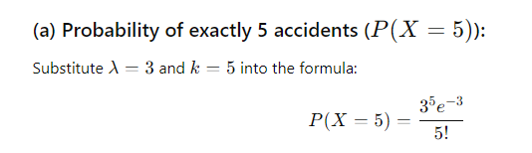
On average, 3 traffic accidents per month occur at a certain intersection. What is the probability that in any given month at this intersection (a) exactly 5 accidents will occur? (b) fewer than 3 accidents will occur? (c) at least 2 accidents will occur?

Slide 9
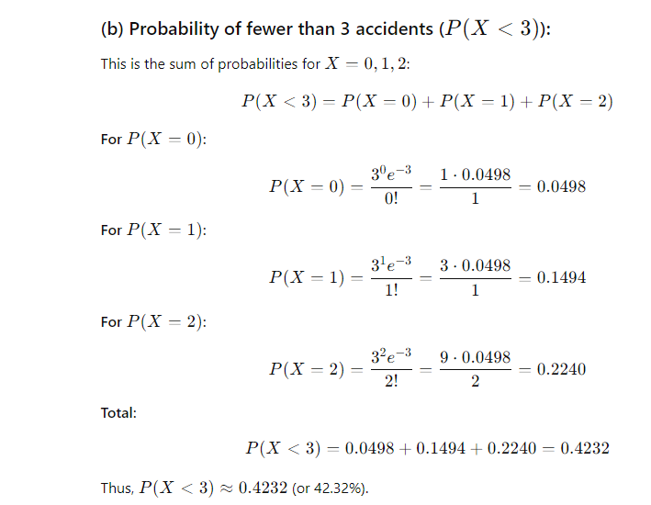

Slide 10
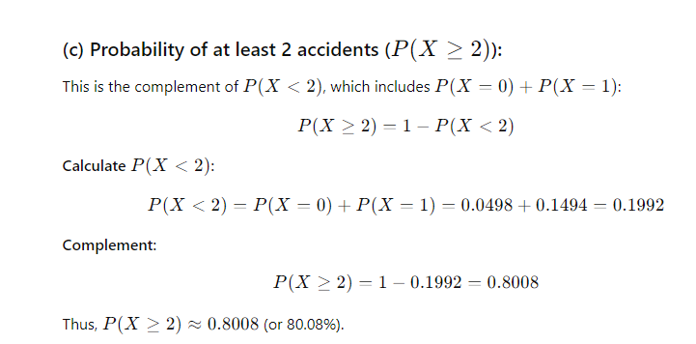

Slide 11
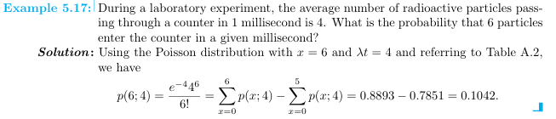

Slide 12
The negative binomial distribution is a generalization of the geometric distribution. Both distributions are related to the binomial distribution, but they differ in how the random variable is defined. The geometric distribution is used when trials are performed until the first success, while the negative binomial distribution is used when trials are performed until a specific number of successes are achieved.

Slide 13
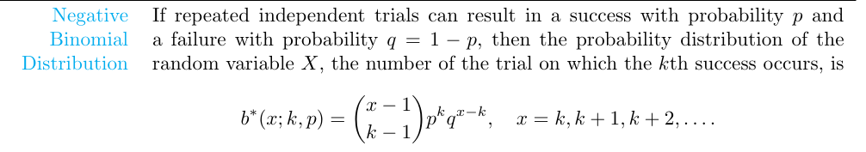
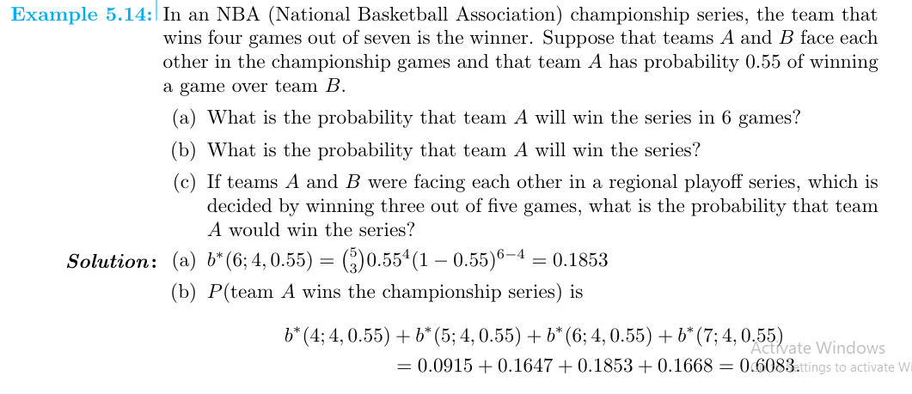

Slide 14
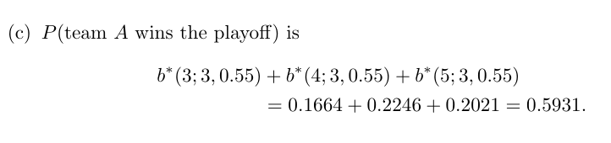

Slide 15
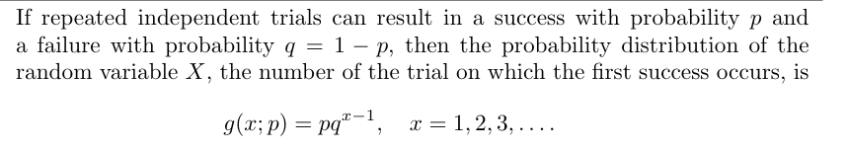
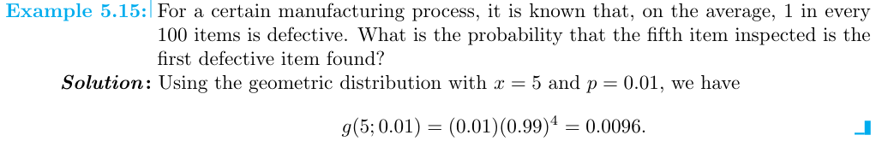

Slide 16
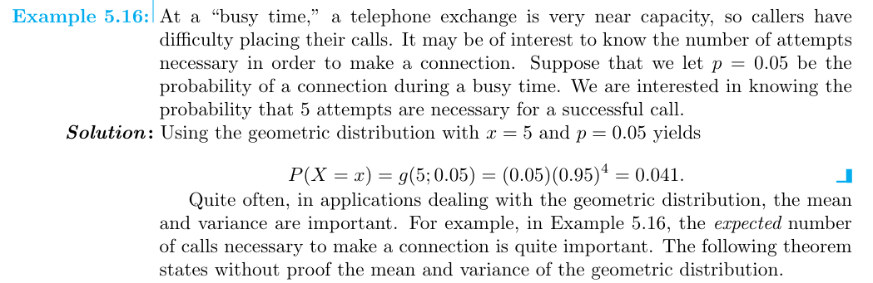
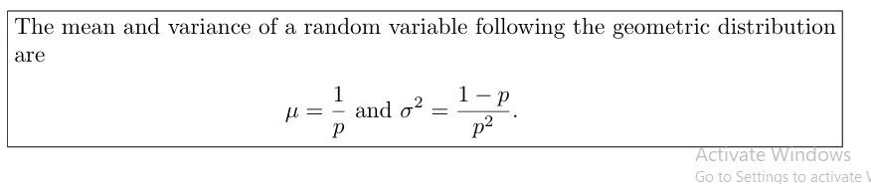
P(X = x) = (1 - p)^{x - 1}p

